Slide 1


Ryan Dahl

Slide 2
Topics
NODE CORE API BASICS
  Event-Driven Programming
  Async Programming
WORKING WITH MODULES
  Understanding how Node loads modules
  Loading Modules
  Using Node Package Manager
  Exporting a Module
EVENT EMITTER PATTERN AND EVENT BINDING
  Understanding the Event Emitter Pattern
  Event Types and Event Emitter API
  Binding/Un binding Event Listeners
  Creating Event Emitter

Slide 3
Topics
FILE I/O
  Manipulating File Paths
  Introducing the fs Module
  Reading and writing to and from Files
STREAMS OF DATA
  Using a Readable Stream
  Using Writable Streams
  Readable and Writable Streams Using pipe()
UNDERSTANDING THE CONNECT HTTP MIDDLEWARE
  Creating Asynchronous Middleware
  Using the HTTP Middleware

Slide 4
Introduction
An Open Source Java Script Platform used to develop fast and scalable server-side and networking applications very easily.
Developed by Ryan Dahl in 2009
JavaScript applications outside web browsers.
Built on Google Chrome's JavaScript Engine (V8 Engine).
Used for event driven, non-blocking (asynchronous) I/O Operations

Slide 5
Client Side JS and Node JS
Client-side JS makes heavy use of the DOM,with no access to files/databases
Server-side JS deals mostly in files/databases,
Provides a rich library of various JavaScript modules which simplifies the development of web applications
Node.js = Runtime Environment + JavaScript Library

Slide 6
Advantage of NodeJS
One Language and One Data Format
  Java Script is the One and only one language to write whole applications
  Code all layers from UI to Controller to Business Layer to Persistence Layer
  JSON Format is supported in all layers
Open Source
  Provides many modules for free to use in our applications.
Better Performance and Low Latency
  Follows Non-Blocking IO architecture
  Since applications are built with only JavaScript results in better performance and low latency.
  Using MEAN Stack, can achieve very high performance.

Slide 7
Use Case for Node.js
Node JS Platform can be used to develop the following kind of applications.
  Network applications
  Proxy Server
  Multiplayer Game Applications
  Web Applications
  High Definition(HD) Voice and Video Communications
  File Uploading Tools
  Process Monitoring Tools
  Many-To-Many Instant Chatting Applications
  HTTP Web Server
  Streaming Server

Slide 8
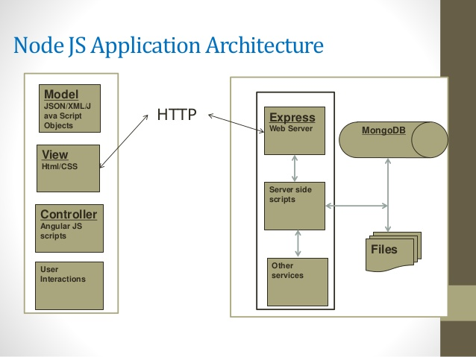
Node Application Architecture

Slide 9
Installation
Download From : http://nodejs.org/#download
Check the Application Running
  Type “node” and enter
  Type ‘Hello From Node JS’
  The text gets printed shows node is installed correctly
Create a JS File
From the Command Prompt node xxx.js

Slide 10
Node JS Platform Components
Has many components to develop, test and deploy Enterprise applications.
  Node CLI
  NPM
  package.json
  Node Modules
  Development Tools and Frameworks
_x000b_

Slide 11
Command Line Interface
Used to run basic commands and also script files.
Available by default
Also known as REPL
  Read-Evaluate-Print-Loop.
started by invoking node on console

Slide 12
Command Line Interface
> "10 + 20"
> "Hello" + "World"
> var x = 10, y = 20;
> x + y
>function add(a, b){ return a+b; }
>add(4,5)

Slide 13
REPL Commands
ctrl + c − terminate the current command.
ctrl + d − terminate the Node REPL.
.help − list of all commands.
.break − exit from multiline expression.
.clear − exit from multiline expression.
.save filename − save the current Node REPL session to a file.
.load filename − load file content in current Node REPL session.

Slide 14
Node Package Manager
Used to install, update, uninstall and configure modules/packages
  Node JS Base Platform, installs only few components, modules and libraries
  NPM Module is available by default
Uses an online repository for open-source Node.js packages.
It has useful modules and many developers publishes to it
Popular package
  AngularJS, jQuery, Gulp, Bower etc.
Official website: https://www.npmjs.com

Slide 15
NPM Operations
Two Modes :
  global and local.
  Global mode : Performs operations which affect all the Node.js applications on the computer
  Local mode : Performs operations for the particular local directory which affects an application in that directory only.
C:\>npm install <package name>
Global packages into <User>/local/lib/node_modulesfolder.
C:\MyNodeProj> npm install -g expressUpdate

Slide 16
Npm install
NPM always installs the latest version
Can install specific version by defining it in package.json file in the local directory
-g or --global
  to install the package globally rather than locally.
-f or --
  force npm to fetch remote resources even if a local copy exists on disk.

Slide 17
Npm Install- Optional Flags
Optional flags which save or update the package version in package.json:
save: save a value to dependencies. Defaults to false
-S, --save:
  Package will appear dependencies.
saveDev: save a value to devDependencies. Defaults to false
-D, --save-dev:
  Package will appear development Dependencies.
-O, --save-optional:
  Package will appear in optional Dependencies.

Slide 18
Node Package Manager
NPM uninstall
  to uninstall or remove an existing module;
NPM update
  to update an existing module;

Slide 19
Package.json
Used to manage application required module dependencies.
Placed in application root folder.
Sample package.json file;
  Has a name and version fields. Required entries,
  package.json
  {
  "name": "file_upload", "version": "0.0.1", "dependencies": {
  "express": "^4.8.6",
  "ejs": "^1.0.0",“
  mysql": "^2.4.3"
  }}

Slide 20
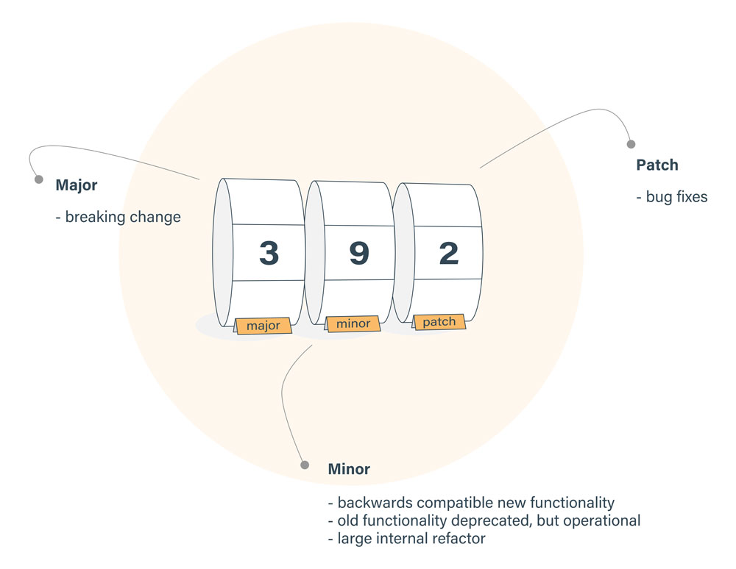
(^) Packages.json
Locks down the major version number, but leaves the minor and patch versions to be more flexible.
Version of ^2.2.3, will match any version that is greater than or equal to 2.2.3 and also less than 3.0.0.

Slide 21
(~) Packages.json
Fixes both the major and minor version numbers, while matching any patch number
~2.3.1,
  Would match all versions greater than or equal to 2.3.1 and less than 2.4.0 for that dependency.
Dependency with a version of '*' would equate to any version that was greater than or equal to 0.0.0,
while 1.* would allow versions greater than or equal to 1.0.0 and less than 2.0.0.

Slide 22
Package.json
name - name of the package
version - version of the package
description - description of the package
homepage - homepage of the package
author - author of the package
contributors - name of the contributors to the package
dependencies - list of dependencies. npm automatically installs all the dependencies mentioned here in the node_module folder of the package.
repository - repository type and url of the package
main - entry point of the package
keywords - keywords

Slide 23
Node.js Module:
Node JS is more modular platform.
Each functionality is implemented by a separate module or package.
Module are organized with single or multiple JavaScript files
  Reused throughout the Node.js application.
Node.js includes three types of modules:
  Core Modules
  Local Modules
  Third Party Modules

Slide 24
Modules
Many programming Languages use the import function to load other libraries
Node can also load other dependencies using the require keyword.
Modules created locally in Node.js application.
  They are placed in a separate JavaScript file.
var http = require('http');
var dns = require('dns');
We can also require relative files:
var myFile = require('./myFile');

Slide 25
Creating Modules
Modules are loaded once, and after that they are cached by Node.
Unlike the browser, Node does not have a window global object, but instead has two others: globals and process.
  Should avoid adding properties on the two.
module.exports or exports to expose a function, object or variable as a module in Node.js.

Slide 26
Module
  var bankModule ={};
  bankModule.simpleInterest=function(){
  return "SimpleInterest Calculation Invoked";
  }
  bankModule.compoundInterest=function(){
  return "Compound Intrest calculation Invoked";
  }
  module.exports = bankModule;

Slide 27
Application
  Loading the Local Module
  var module = require("./PaymentModule.js");
  console.log(module.simpleInterest());
  console.log(module.compoundInterest());

Slide 28
Modules
  To Export a function, place the contents of module in line with the export of the module.
  exports.calculate=function(){
  var amt = (5000 * 2 * 3)/100;
  return amt;
  }
  var obj = require("./CalculateModule.js").calculate;
  console.log(obj);

Slide 29
Module Pattern
  EXPORT AN ANONYMOUS OBJECT
  var Employee = function() {};
  Employee.prototype.getRole = function() {
  console.log('Inside Role');
  return 'developer';
  };
  module.exports = new Employee();
var emp = require('./MyModule');
console.log(emp.getRole());

Slide 30
Module Pattern
EXPORT A NAMED OBJECT
  var Employee = function() {};
  Employee.prototype.getRole = function() {
  console.log('Inside Role');
  return 'developer';
  };
  exports.employee = new Employee();
  var emp = require('./MyModule').employee;
  console.log(emp.getRole());

Slide 31
Module Pattern
EXPORT A NAMED PROTOTYPE
  var Employee = function() {};
  Employee.prototype.getRole = function() {
  console.log('Inside Role');
  return 'developer';
  };
  exports.employee = Employee;
  var emp = require('./MyModule').employee;
  var obj = new emp();
  console.log(obj.getRole());
  Named exports - one module, many exported things
  Anonymous exports - simpler client interface

Slide 32
Core Module
Include bare minimum functionalities of Node.js.
Compiled into its binary distribution and load automatically when Node.js process starts.
  Need to import the core module to use it in application.
http :
  http module includes classes, methods and events to create Node.js http server.
Path
  path module includes methods to deal with file paths.
fs
  fs module includes classes, methods, and events to work with file I/O.
Util
  util module includes utility functions useful for programmers.

Slide 33
Loading Core Modules
Core module are imported require() function
  var module = require('module_name');
  var util =require("util");
  console.log("Hello");
  setTimeout(function () {
  console.log("World!");
  }, 3000);
    //it prints ‘hello’ first and waits for 3 seconds and then prints ‘world’

Slide 34
Process Object
The process object is a global object and can be accessed from anywhere.
It has several methods properties and events
process.stdout.write("Hello World!" + "\n");
    console.log(process.execPath);
    console.log(process.platform);
    console.log('Current directory: ' + process.cwd());
    console.log(process.memoryUsage());

Slide 35
Inheritance
  function Employee() {}
  Employee.prototype.calculateWage =function() {
  return 'Calculating Employee Wages...';
  };
  module.exports = Employee;

Slide 36
Sub Class
  var Employee = require('./Employee.js');
  var util = require('util');
  function Manager() {
  Employee.apply(this,arguments);
  }
  util.inherits(Manager,Employee);
  Manager.prototype.calculateWage = function() {
  var msg= Employee.prototype.calculateWage();
  return msg+'Calculating Manager wages';
  };
  module.exports = Manager;

Slide 37
Application
  var mgr = require("./Manager.js");
  var obj = new mgr();
  console.log(obj.calculateWage());

Slide 38
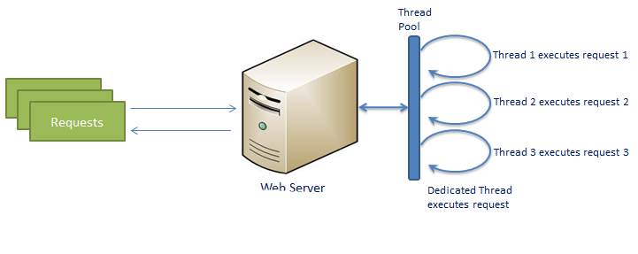
Traditional Web Server

Slide 39
Traditional Web Server Model:
Each request is handled by a dedicated thread from the thread pool.
Web Server picks up one and assign it for every Client Request
  It will take care of reading Client request, processing Client request, performing any Blocking IO Operations and preparing Response
  This model creates one Thread per Client request.
  If more clients requests require Blocking IO Operations, then almost all threads are busy in preparing their responses.
  Then remaining clients Requests should wait for longer time.

Slide 40
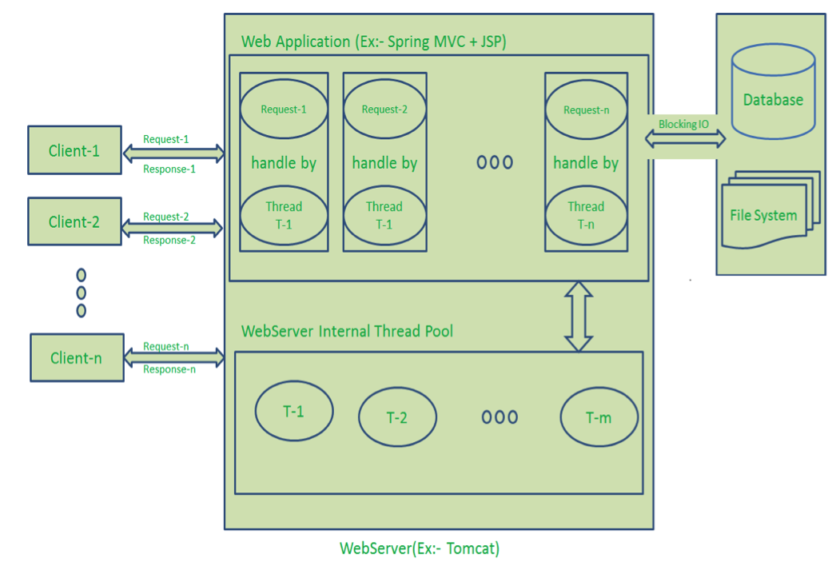
Traditional Web Server

Slide 41
Drawbacks of Traditional Model
  Handling more and more concurrent client’s request is bit tough.
  When Concurrent client requests increases, then it should use more and more threads, finally they eat up more memory.
  Sometimes, Client’s Request should wait for available threads to process their requests.
  Wastes time in processing Blocking IO Tasks.

Slide 42
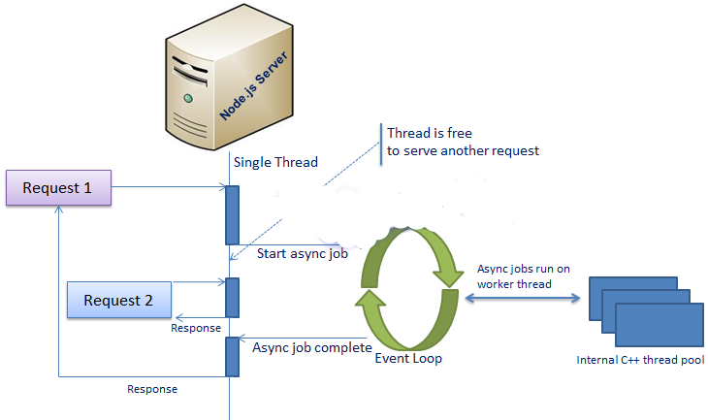
NodeJS Server

Slide 43
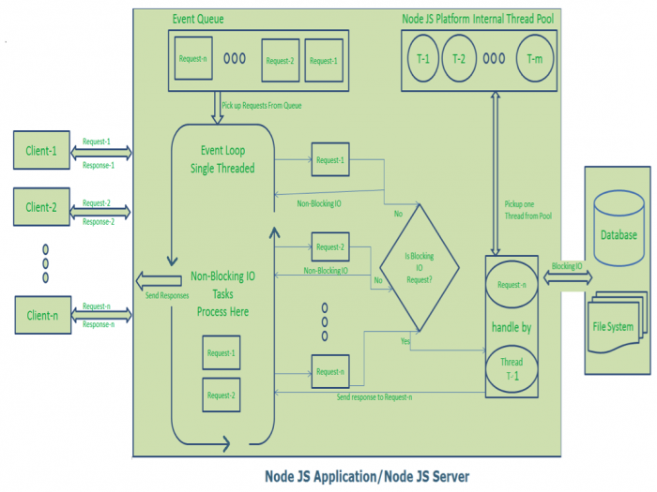
NodeJS Server

Slide 44
Single Threaded Event Loop Model
Node uses “Single Threaded Event Loop” architecture to handle multiple concurrent clients.
Based on Javascript Event based model with callback mechanism.
  Can handle more and more concurrent client requests very easily.
  Done By a Processing model known as “Event Loop”
  Event Loop uses single Thread only
Event loops constantly watch a asynchronous job
  Executes callback function when the job completes.

Slide 45
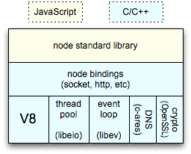
Event-loops
Event-loops are the core of event-driven programming,
Client
Clients send HTTP requests
to Node.js server
Event loop
(main thread)
Event loop returns
result to client
An Event-loop is woken up by OS,
passes request and response objects
to the thread-pool
Long-running jobs run
on worker threads
Response is sent
back to main thread
via callback
C++ Threadpool
(worker threads)

Slide 46
Event Loop and Event Queue
Clients Send request to Web Server.
Server maintains a Limited Thread pool to provide services to the Client Requests.
Request are placed into “Event Queue” which uses Event loop to receive requests and process them.
  Event Loop checks any Client Request is placed in Event Queue.
  If no, then wait for incoming requests for indefinitely.
  If yes, then pick up one Client Request from Event Queue
    Start processing that Client Request

Slide 47
Single Threaded Event Loop Model
Non Blocking Client Request
  Does Not requires any Blocking IO Operations, then process everything, prepare response and send it back to client.
  Blocking Client Request
  Requires Blocking IO Operations like interacting with Database, File System, External Services
    Checks Threads availability from Internal Thread Pool
    Picks up one Thread and assign the Client Request to that thread.
    Thread process it, perform Blocking IO operations,
    Prepares Response and send it back to the Event Loop
    Event Loop in turn, sends that Response to the respective Client._x000b_

Slide 48
Single Threaded Event Loop Advantages
Handling more and more concurrent client’s request is very easy.
Even though our Node JS Application receives more and more Concurrent client requests, there is no need of creating more and more threads, because of Event loop.
Node JS application uses less Threads so that it can utilize only less resources or memory

Slide 49
ASYNC PROGRAMMING

Slide 50
Blocking and Non Blocking I/O
Traditional I/O
  var result = db.query(“select x from table_Y”);
  doSomethingWith(result); //wait for result!
  doSomethingWithOutResult(); //execution is blocked!
Non-traditional, Non-blocking I/O
  db.query(“select x from table_Y”,function (result){
  doSomethingWith(result); //wait for result!
  });
  doSomethingWithOutResult(); //executes without any delay!

Slide 51
Synchronous programming
The code works sequentially, executing each line after the next.
The next line is not executed until the previous line finishes executing.
  var fs = require('fs');
  var content = fs.readFileSync('simpleserver1.js','utf-8');
  console.log('File content: ');
  console.log(content);

Slide 52
Asynchronous programming
Node uses Call Back events to a single thread with Asynchronous programming
  Helps in improving performance and decreasing I/O wait time between requests.
  fs.readFile('abc.txt', 'utf-8', (err, data) => { console.log(data) });
  console.log('Done');

Slide 53
EVENT-DRIVEN PROGRAMMING

Slide 54
Event Driven Programming
Event Emitters helps in avoid callback hell.
  They emit an event after an asynchronous function is done,
Callbacks will have more logic inside it
Call Backs works like an event but it is called only when an asynchronous function returns its result.

Slide 55
Asynchronous Events
A main loop listens to these events and immediately triggers a callback function
Events works on an observer pattern
The functions which listen to the events act as Observers. when an event gets fired, the execution of the listener function starts immediately.
Event Handler can react to the same signal multiple times by defining multiple listeners.

Slide 56
Asynchronous Call With Event Handling
  var EventEmitter = require('events').EventEmitter;
  var emitter = new EventEmitter();
  var fs = require('fs');
  emitter.on('start_read', function(file_name) {
  console.log("Started Reading file....\n\n");
  fs.readFile(file_name, 'utf8', function(err, data) {
  if (err) {
  console.log("Error happens.");
  } else {
  console.log("File data", data);
  }
  });
  });
  emitter.emit('start_read', 'abc.txt');
  emitter.emit('start_read', 'pqr.txt');

Slide 57
EVENT EMITTING

Slide 58
Event Emitter
Can create and handle custom events by using events module.
  It has a EventEmitter to raise and handle custom events.
  Used for asynchronous event-driven architecture.
  Many of Node’s built-in modules inherit from EventEmitter.
All objects that emit events are instances of the EventEmitter class.
on
  Used to add listener functions
  Listener functions will be executed every time the emitter object emits their associated name event.
emit
  Used to emit any named event
  A signal that some condition has occurred.
  Condition is usually about a state change in the emitting object.

Slide 59
Event Emitter
  events = require('events');
  var eventEmitter = new events.EventEmitter();
  eventEmitter.on('myevent',
  function(data){
  console.log('an event occurred!‘+data);
  });
  eventEmitter.emit('myevent‘,”Hello World”);
  Events !== Asynchrony

Slide 60
Event Emitter
  var emitter = require('events').EventEmitter;
  var em = new emitter();
  em.addListener('FirstEvent', function (data) { console.log('First subscriber: ' + data); });
  em.on('SecondEvent', function (data) { console.log('First subscriber: ' + data); });
  em.emit('FirstEvent', 'This is my first Node.js event emitter example.');
  em.emit('SecondEvent', 'This is my second Node.js event emitter example.');

Slide 61
Event Emitter
  var emitter = require('events').EventEmitter;
  function LoopProcessor(num) {
  var e = new emitter();
  setTimeout(function () {
  for (var i = 1; i <= num; i++) {
  e.emit('BeforeProcess', i);
  console.log('Processing number:' + i);
  e.emit('AfterProcess', i); } } , 2000)
  return e; }
  var lp = LoopProcessor(3);
  lp.on('BeforeProcess', function (data) { console.log('About to start the process for ' + data); });
  lp.on('AfterProcess', function (data) { console.log('Completed processing ' + data); });

Slide 62
Event Emitter
  const EventEmitter = require('events');
  class WithLog extends EventEmitter {
  execute(taskFunc) {
  console.log('Before executing');
  this.emit('begin');
  taskFunc();
  this.emit('end');
  console.log('After executing');
  }
  }
  const withLog = new WithLog();
  withLog.on('begin', () => console.log('About to execute'));
  withLog.on('end', () => console.log('Done with execute'));

Slide 63
Event Emitter
Before executing
About to execute
*** Executing task ***
Done with execute
After executing

Slide 64
Set Immediate
The function to call at the end of f the Node.js Event Loop
  will execute the callback from the queue containing it
  withLog.execute(() => {
  setImmediate(() => {
  console.log('*** Executing task ***')
  });
  });
  Before executing
  About to execute
  Done with execute
  After executing
  *** Executing task ***

Slide 65
File System:
fs module is used to access physical file system.
  responsible for all the asynchronous or synchronous file I/O operations.
fs.readFile(fileName [,options], callback)
filename:
  Full path and name of the file as a string.
options:
  can be an object or string which can include encoding and flag.
  The default encoding is utf8 and default flag is "r".
callback:
  A function with two parameters err and fd.
  This will get called when readFile operation completes.

Slide 66
Reading From File
  var fs = require('fs');
  fs.readFile('TestFile.txt', function (err, data)
  {
  if (err) throw err;
  console.log(data);
  });
  var fs = require('fs');
  var data = fs.readFileSync('dummyfile.txt', 'utf8');
  console.log(data);

Slide 67
Writing File:
writeFile()
  write data to a file.
  If file already exists it overwrites else creates a new file and writes data into it.
fs.writeFile(filename, data[, options], callback)
  var fs = require('fs');
  fs.writeFile('test.txt', 'Hello World!', function (err) {
  if (err) console.log(err);
  else
  console.log('Write operation complete.');
  });

Slide 68
Creating & Writing File
To append the content to an existing file.
  var fs = require('fs');
  fs.appendFile('test.txt', 'Hello World!', function (err) {
  if (err) console.log(err);
  else console.log('Append operation complete.'); });

Slide 69
HTTP MODULE

Slide 70
Create Http Server
createServer()
  method includes request and response parameters which is supplied by Node.js.
  Set Up with callback function.
listen()
  To start listening to incoming requests on port 5000.
  Can specify any unused port here.

Slide 71
Creating Http Server
  const http = require('http');
  const hostname = '127.0.0.1';
  const port = 3000;
  try {
  const server = http.createServer((req, res) => {
  res.statusCode = 200;
  res.setHeader('Content-Type', 'text/plain');
  res.end('Hello World\n');
  });
  } catch (error) {
  console.log(error);
  }
  server.listen(port, hostname, () => {
  console.log(`Server running at http://${hostname}:${port}/`);
  });

Slide 72
Sending JSON Response
  var http = require('http');
  var server = http.createServer(function (req, res) {
  if(req.url==='/data'){
  res.writeHead(200,{'Content-Type':'application/json'});
  res.write(JSON.stringify({message:"Hello World"}));
  res.end();
  }
  });
  server.listen(5000);
  console.log("Server Started in port 5000");

Slide 73
TCP/IP SERVER

Slide 74
TCP/IP
TCP/IP uses the client/server model of communication in which a client requests and is provided a service by another computer a server in the network.
Its is primarily point-to-point,
  Communication is from one point in the network to another point or host computer.

Slide 75
TCP/IP
TCP socket programs consists of writing a server and client.
A TCP server listens for connections to it from clients and send data to the client.
A TCP client connects to a TCP server exchange data with it.
The communication between client and server happens via sockets.
Node requires the net module, which is an asynchronous wrapper for network programming.

Slide 76
Net Module
Contains methods for creating both servers and clients
net.createServer([options], [connectionListener])
Creates a new TCP server.
The connectionListener argument is automatically set as a listener for the 'connection' event.

Slide 77
TCP/IP Server
  var net = require('net');
  var PORT = 5000;
  var ADDRESS = '127.0.0.1';
  var server = net.createServer(onClientConnected);
  server.listen(PORT, ADDRESS);
  function onClientConnected(socket) {
  var client = socket.remoteAddress+":"+socket.remotePort;
  console.log(client+'connected.');

Slide 78
TCP/IP Server
  socket.on('data', function(data) {
  var m = data.toString();
  console.log(client+'said'+m);
  socket.write('We got your message'+m+'Thanks!');
  });
  socket.on('end', function() {
  console.log(client+' disconnected.');
  });
  }
  console.log('Server started at:'+ ADDRESS+':'+PORT);

Slide 79
TCP/IP Client
  var net = require('net');
  var client = new net.Socket();
  client.connect(5000, '127.0.0.1', function() {
  console.log('Connected');
  client.write('Hello, server! I am Client.');
  });
  client.on('data', function(data) {
  console.log('Received: ' + data);
  client.destroy();
  });
  client.on('close', function() {
  console.log('Connection closed');
  });

Slide 80
STREAMS

Slide 81
Streams
Streams are objects used read and write data in continuous fashion.
Readable − Streams used for read operation.
Writable − Stream used for write operation.
Duplex − Stream for both read and write operation.
Transform − A type of duplex stream where the output is computed based on input.

Slide 82
Streams Event Emitter
Streams are an instance of Event Emitter
  They throw several events at different times.
Commonly used events are
data
  Fired when data is available to read.
end
  Fired when there is no more data to read.
error
  Fired when there is any error receiving or writing data.
finish
  Fired when all the data has been flushed

Slide 83
Reading from a Stream
  var fs = require("fs");
  var data = '';
  var readerStream = fs.createReadStream('input.txt');
  readerStream.setEncoding('UTF8');
  readerStream.on('data', function(chunk) { data += chunk; });
  readerStream.on('end',function(){
  console.log(data); });
  readerStream.on('error', function(err){
  console.log(err.stack);
  });

Slide 84
Writing to Stream
  var fs = require("fs");
  var data = 'Simply Easy Learning';
  var writerStream = fs.createWriteStream('output.txt');
  writerStream.write(data,'UTF8');
  writerStream.end();
  writerStream.on('finish', function() { console.log("Write completed."); });
  writerStream.on('error', function(err){ console.log(err.stack); });

Slide 85
Piping Streams
A way by which output of one stream as the input to another stream.
Used to manage the flow of data without
  Can get data from one stream and to pass the output of that stream to another stream.
pipe() :
  pipe() returns the destination stream.
  Handles all flow control

Slide 86
Pipe Streams
  var fs = require("fs");
  var pipeModule = {};
  pipeModule.example= function(){
  var rstream = fs.createReadStream('input.txt');
  var wstream = fs.createWriteStream('output.txt');
  rstream.pipe(wstream);
  rstream.on('end',function(){
  console.log("Done");
  });
  };
  module.exports=pipeModule;

Slide 87
Streams and Buffers
File read is fully buffered method. and streaming is partial buffered method.
readFileSync() and readFile()
  expose the data as one Fully buffered function calls like big blob.
  reading is performed and then the full set of data is returned either in synchronous or asynchronous fashion.
  Need to wait until all of the data is read
  Need to allocate enough memory to store all of the data in memory.
  Can be problematic incase of file with Huge size

Slide 88
Streams and Buffers
Streams are Partially buffered access
Streams are EventEmitters.
Events occur as the data is being read or written.
  They do not treat data input as a discrete event, but rather as a series of events
  returns smaller parts of the data (using a Buffer), and trigger a callback when new data is available for processing.
Access data as it is being read from disk/network/other I/O.
They don’t hold all of the data in memory in some buffer: after processing

